Slide 1
Enhancing Patient Triage Efficiency and Capacity in Montanaro Hospital's Observation Unit
Kavya Chandran

Slide 2
Introduction
Dr. Erin Kelly, overseeing Montanaro Hospital's 23-bed Observation Unit (OU), has identified extended patient stays and frequent transitions from observation to inpatient status as areas of concern. With the OU operational for just over a year, Dr. Kelly is undertaking a comprehensive review of protocols and aims to enhance patient placement procedures to optimize care delivery.

Slide 3
Key Challenges
Extended Length of Stay from Observation to Inpatient Movement
Inefficient Utilization of the Observation Unit
Patients stayed longer than initially intended

Slide 4
Objectives
Enhance Operations in the Observation Unit for Precise and Efficient Patient Triage.
Reduce Instances of Patients Leaving Without Receiving Attention.
Optimize Observation Unit Capacity, Enhance Patient Flow, and Boost Hospital Revenue.

Slide 5




Methodology
Business Problem
Business Understanding
Data Comprehension
Data Preprocessing
Data Cleaning
Model
Model Creation
Model Evaluation
Feature Engineering
Implementation
Recommendation

Slide 6
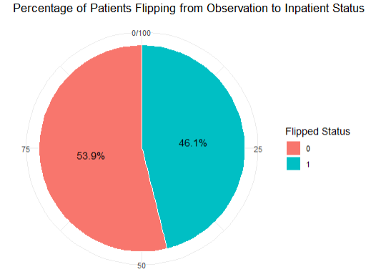
Descriptive Analytics
Observations
Target Variable
1111 Observations
17 Variables (Binary, Categorical & Numeric)
Additional Variables
“Flipped”
BP Category
Temperature Category
Age Category
 | Before | After
Observations | 1111 | 1111
Variables | 15 | 17

Slide 7
Data Description
Variables | Government
Age | Age of Patient, in Years
Gender | Patient Gender(Male/Female)
Flipped | Binary Variable (1 – Patient Flipped, 0 – Patient stayed in OU)
OU_LOS_hrs | Length of stay in OU in Hours
DRG01 | Initial Diagnosis related group
BloodPressureLower | Diastolic (mm Hg)
BloodPressureUpper | Systolic (mm Hg)
BloodPressureDiff | Difference between systolic and diastolic
Variables | Government
Pulse | Patient Pulse
Pulse Oximetry | Measure of level of Oxygen in patient blood
Respirations | No. of breaths patient takes per minute
Temperature | In F
Temperature Category | <97 – Below Normal >= 97 & <= 100 Normal > 100 Fever
BP Category | sys < 120 & dia < 80, "Normal“, sys >= 120 & sys <= 129 & dia < 80, "Elevated", sys >= 130 & sys <= 139 & dia >= 80 & dia <= 89, "Hypertension Stage 1", sys >= 140 & dia >= 90, "Hypertension Stage 2", sys > 180 | dia > 120, "Hypertensive Crisis"

Slide 8
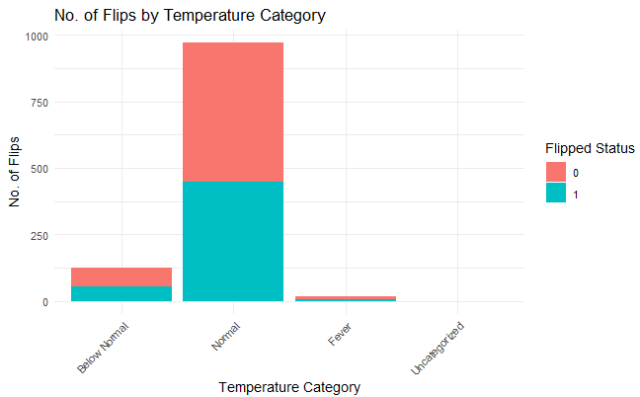
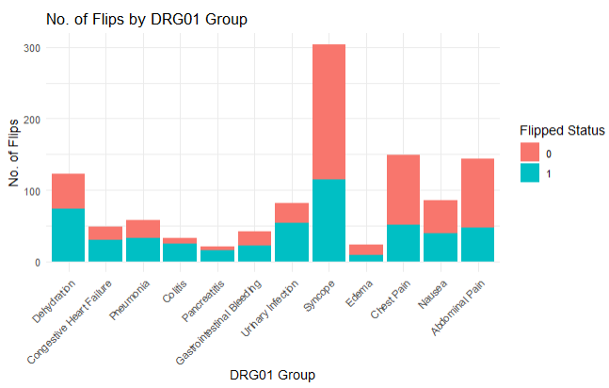
Analysis of Patient Flips
Temperature Category
Primary diagnosis group

Slide 9
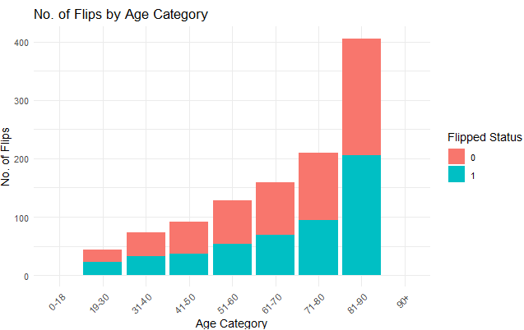
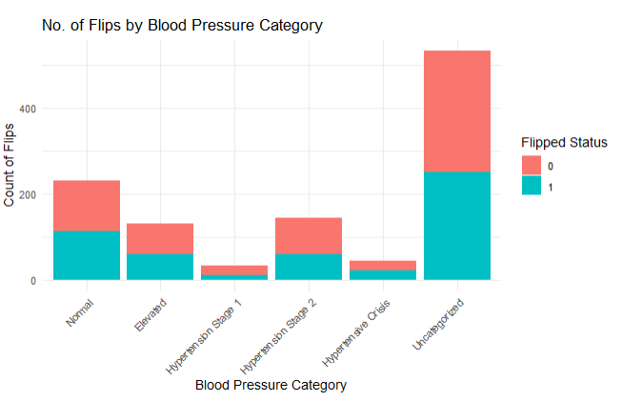
Analysis of Patient Flips
Age Category
BP Category

Slide 10
Flipped Patient Summary
53% Flipped Patients
Top 3 Categories | No. Flipped | % Flipped
Normal Temperature | 449 | 87.70%
Prehypertension | 250 | 48.83%
Age 81-90 | 205 | 40.04%

Slide 11
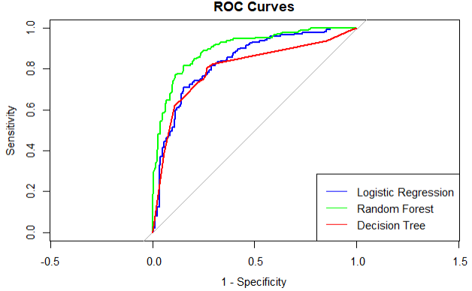
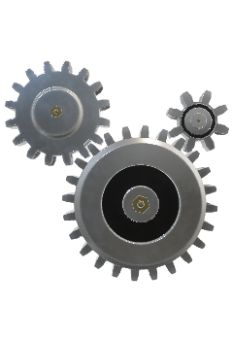
Model Building
Model | Logistic Regression | Random Forest | Decision Tree | Baseline Accuracy
Accuracy | 0.76 | 0.82 | 0.77 | 53%
AUC | 0.84 | 0.76 | 0.73
Sensitivity | 0.70 | 0.88 | 0.82
Specificity | 0.82 | 0.82 | 0.78

Slide 12
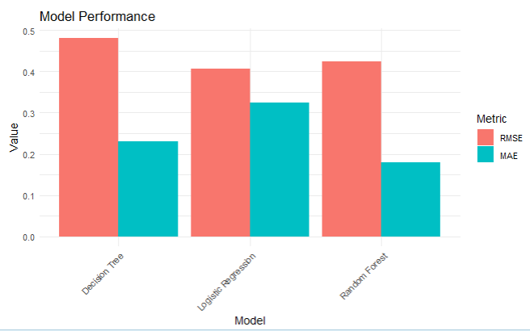
Model Performance

Slide 13




Recommendations
Establishing a Comprehensive Framework for Continuous Data Monitoring and Refinement
Enhancing Staff Training Programs and Facilitating Seamless Model Implementation.
Implementing a Structured Feedback Mechanism to Drive Continuous Improvement.
Facilitating Informed Decision-making
Improved Operations

Slide 14
Thank you

